Slide 1


Approach for Contoso UCIC

Slide 2

Meeting Agenda
Problem Statement and Assumptions
Approach -1
Solving the problem via Supervised Learning Techniques
Approach -2
Azure Search + Nearest Neighbor + Custom Scoring
Approach -3
Approximate Nearest Neighbors Approach
Backup

Slide 3
Problem Statement and Assumptions
Contoso would provide Microsoft with the Golden Corpus of their existing customer base from all group companies until a specific month (For Example: Until March 2019)
This corpus would act as the Master Data or De-Duplicated data till that point and will be a one-time load
This data will be ingested into the Data Lake(Need to be confirmed)
Contoso to provide incremental datasets for subsequent months to perform De-Duplication or Golden Record Matching against the Master/Golden Data
The De-Duplication algorithm to match each record from these incremental files with the Master Data and assign a score for the top 5 matches

Slide 4

Approach -1
Solving the sample problem via Supervised Learning Techniques

Slide 5
Machine Learning for Entity Resolution
Make use of existing matched data from Contoso and build a supervised learning algorithm that can classify if a pair of two given records are duplicates or not
This would require us to go through the following steps
Prepare Training Data From a smaller corpus of Existing Matches
Perform Feature Engineering
Edit Distance Measures ➔ Levenshtein, Jaro Winkler
Jaccard’s Similarity
Fingerprinting ➔ Regular, N-Gram and Phonetic
Address similarity scores
Abbreviation
Length of the Name
Character Counts
Etc.
Build a classification model for evaluation of matches
Predict on new combinations

Slide 6
Machine Learning for Entity Resolution
Prepare Training Data
Perform Feature Engineering
Train a Classification Model
Evaluate Model Performance
Identify Pairs of Duplicates
Consolidate Duplicates
Iterate
Train Cycle
Predict Cycle

Slide 7
Training Data - Snapshot
Raw data to Preprocessed data
Record 1
Record 2
First Name | Last Name | Address | First Name | Last Name | Address | Match (0/1)
Ashish | Kumar | Strium, Block No 216, Andheri - Kurla Rd, C-Wing, Hanuman Nagar, Andheri East, Mumbai, Maharashtra 400059 | Ashish Ranjan | Kumar | No 216, Hanuman Nagar, Andheri East, Mumbai, Maharashtra 400059 | 1
Ashish M | Kumar | Strium, Block No 216, Andheri - Kurla Rd, C-Wing, Hanuman Nagar, Andheri East, Mumbai, Maharashtra 400059 | Ashish Kumar | Mahajan | 131 / B, Link Rd, Chakala, Andheri East, Mumbai, Maharashtra 400099 | 0
… | … | … | … | … | … | …
Levenshtein_Full name | Jaro- winkler | Abbreviation Match | Phonetic Match | Fingerprint FirstName Match | Address Length diff | City Levenshtein | … | … | Match (0/1)
5 | 0.75 | 0 | 1 | 1 | 10 | 2 | … | … | 1
7 | 0.75 | 0 | 2 | 2 | 12 | 2 | … | … | 0
… | … | … | … | … | … | … | … | … | …

Slide 8
Train Classification Model
This preprocessed data will be passed to a Predictive Model for classification
In addition to the extracted features, Character N-Grams can also be identified and a fastText based Word Embeddings may be passed into the model as features
A Deep-Learning based framework such as DeepER or DeepMatcher can also be used for this solution
Evaluation can be based on the same metrics as mentioned earlier
Precision
Recall
F1 etc.

Slide 9
Inference/Prediction - Cycle
Once Model is trained during the prediction, tuples of similar records are extracted
Similar matches then can be consolidated to form groups and assign a single id
To avoid, inference against all pairs, Azure Search can be used to extract similar records and perform prediction on only those records for time efficiency
To identify similar records, the inference of a given record can only be performed on those records that have the same first character and last character of the given record

Slide 10
Advantages and Challenges
Unlike unsupervised learning
This is a more controlled solution
Evaluation of the solution becomes very easy
Model retraining could yield better results
The only challenge would be to prepare or create a good training set.
This can happen incrementally, and model can be retrained as we go along into future iterations with better and larger datasets

Slide 11
Approach -2
Azure Search + Nearest Neighbor + Custom Scoring

Slide 12
Matching Algorithm
The Incremental Files will go through 2 Phases of Matching/De-Dup
Exact Match – This will happen through the following fields
PAN Number
Passport
Driving License
AADHAAR
Phone Number etc.
Specific Rules can be defined on how this exact Matching can be performed based on the above fields. All the records in the incremental files that are not matched with this Exact Match Scenario will then be sent through the Fuzzy Matching/De-Dup approach.
Fuzzy Match Scenario – This is where all the records that haven’t matched successfully with the Exact Match will be attempted for matching against the Golden Data
This will happen through a combination of many algorithms/techniques that are detailed out in the subsequent slides with the necessary preprocessing steps.

Slide 13
Data Pre-Processing | Azure Search Indexing of Master Data /Golden Data
All the demographic fields identified for the De-Dup process will be indexed into Azure Search split by the States or any other controllable field if possible.
Creating multiple indexes in Azure Search would help in reducing the latency of retrieval
Fields such as Full Name / First Name/Last Name will go through a round of normalization and Feature Extraction
Normalization
Removal of Special Characters
Converting into lower case etc.
Fingerprinting will be performed on Names and stored as additional columns in Azure Search
Regular Fingerprinting (Example for Spelling Variation)
N-Gram Fingerprinting (N needs to be identified through exploration. Typically 1 or 2 works)
Phonetic Fingerprinting
Abbreviation Extraction
Extract Abbreviations of Names and Store them. This would help in ensuring that all variations of Names
Perform Address Cleansing
Cleanse Postal Codes
Cleanse States to 2-Character Strings
Remove special characters from Addresses
First Name | Last Name | Name Abbreviation
Ashish Kumar | Ranjan | AKR
Ashish K | Ranjan | AKR
Ashish Kumar | R | AKR

Slide 14
Matching an Input Record – A Hybrid Approach
Each input record will go through the same pre-processing steps as of the golden record
Matching will happen in two steps
Extract Probable Matches – Ensuring High Recall
Score Matches and Find best match – Ensuring High Precision

Slide 15
Matching an Input Record – Extract Probable Matches
Extract Probable Matches from Azure Search that satisfy any of the following conditions.
First Name with Fuzzy Matches
Abbreviation Filter
Fingerprint Filters etc.
Other Controllable Field Filters such as State, etc.
This would ensure that all the different variations or probable matches are flown into the pipeline for further scoring of names and addresses

Slide 16
Matching an Input Record – Score Probable Matches
Make use of the probable matches and compute the following:
Name Match Score – This score will be a custom score that is computed as a combination of
Jaro Winkler or Bounded Levenshtein between Input Record and Golden Record Names
# of Fingerprint Matches
Abbreviation Match (Y/N)
This will be a score between [0,1]
Address Match Score - This score will be a custom score that is computed as a combination of
String Similarity of Street Address (After removal of Noise Words i.e. ‘Nagar’, ‘Colony’, ‘Road’, ‘Street’ etc. )
City Match
Postal Code Match
State Match etc.
The above string similarity will also be a score between [0,1].

Slide 17
Matching an Input Record – Ranking the Matches
Final Match Score = n* (Name Score) + (2-n)* Address Score
Where n is a value between (0, 2) that defines that weight for the Name Score
n can be empirically identified based on the evaluation metrics
Recall
Precision
The above formulae are for illustration only

Slide 18
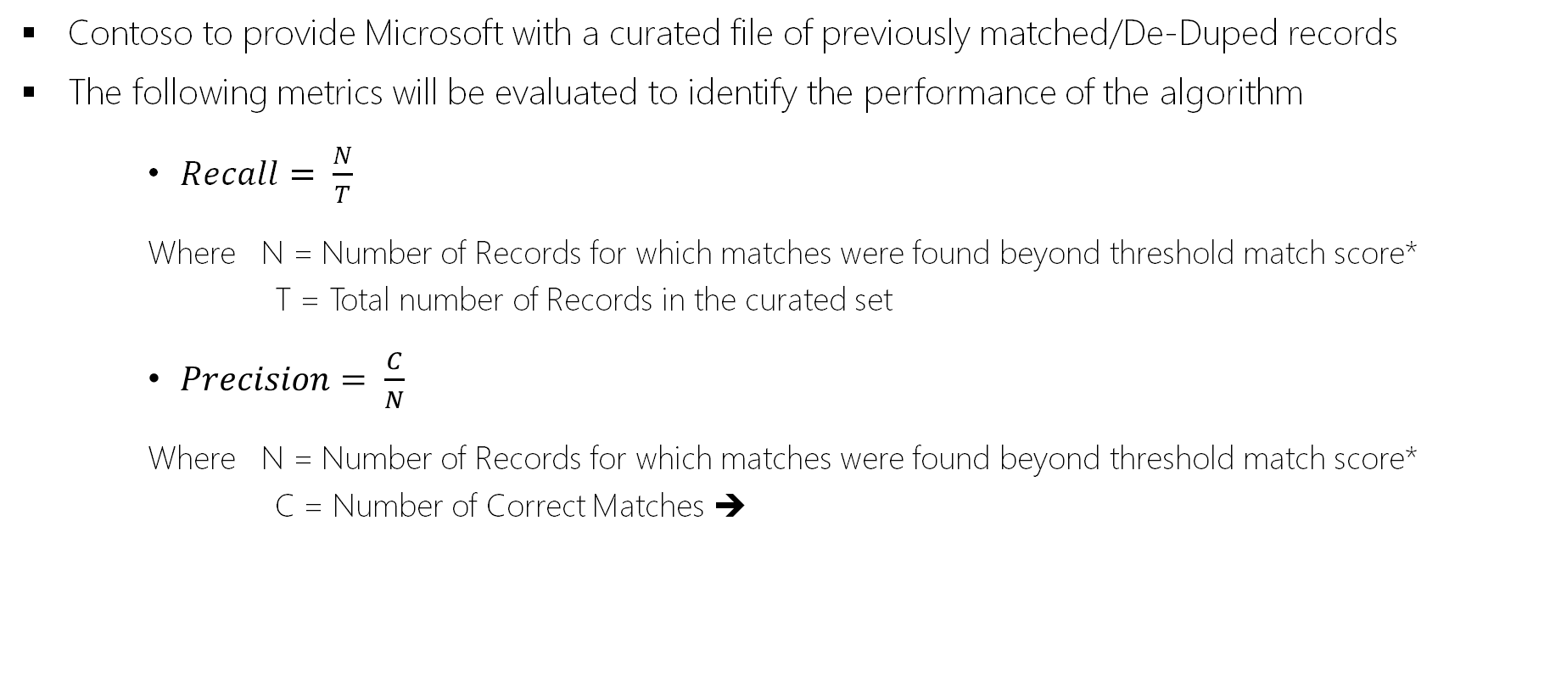
Evaluation
Contoso to provide Microsoft with a curated file of previously matched/De-Duped records
The following metrics will be evaluated to identify the performance of the algorithm
$Recall= \frac{N}{T}$
Where N = Number of Records for which matches were found beyond threshold match score*
T = Total number of Records in the curated set
$Precision= \frac{C}{N}$
Where N = Number of Records for which matches were found beyond threshold match score*
C = Number of Correct Matches ➔

Slide 19
Approach -3
Approximate Nearest Neighbors Approach

Slide 20




Nearest Neighbor Approach
A typical nearest neighbor approach to find the best matches can yield into Quadratic time complexity. Meaning we will have to perform nxn comparisons always to find the duplicates
To avoid this we propose a technique such as Approximate Nearest Neighbor (ANN)
This technique is an improvement on the Approach-1
The typical techniques used here will be
Locality Sensitive Hashing
Dimension Independent Matrix Squares using Mapreduce (DIMUSM)
ANN’s are techniques that don’t always compare all pairs to compare similar records.
They have an efficient way making lesser number of smart comparisons

Slide 21
Backup
xxxxxxx

Slide 22
The Fingerprinting method
The Fingerprinting method is fast and simple yet works relatively well in a variety of contexts and it's the least likely to produce false positives, which is why it is the default method.
The process that generates the key from a string value is the following (note that the order of these operations is significant):
remove leading and trailing whitespace
change all characters to their lowercase representation
remove all punctuation and control characters
normalize extended western characters to their ASCII representation (for example "gödel" → "godel")
split the string into whitespace-separated tokens
sort the tokens and remove duplicates
join the tokens back together
There are several factors that play a role in this fingerprint:
because whitespace is normalized, characters are lowercased, and punctuation is removed, those parts don't play a differentiation role in the fingerprint. Because these attributes of the string are the least significant in terms of meaning differentiation, these turn out to be the most varying parts of the strings and removing them has a substantial benefit in emerging clusters.
because the string parts are sorted, the given order of tokens doesn't matter (so "Cruise, Tom" and "Tom Cruise" both end up with a fingerprint "cruise tom" and therefore end up in the same cluster)
normalizing extended western characters plays the role of reproducing data entry mistakes performed when entering extended characters with an ASCII-only keyboard. Note that this procedure can also lead to false positives, for example "gödel" and "godél" would both end up with "godel" as their fingerprint but they're likely to be different names, so this might work less effectively for datasets where extended characters play substantial differentiation role.

Slide 23
N-Gram Fingerprint and Phonetic Fingerprint
N-Gram Fingerprint
The n-gram fingerprint method is like the fingerprint method described above but instead of using whitespace separated tokens, it uses n-grams, where the n (or the size in chars of the token) can be specified by the user.
Here is what it does (or check the code if you're curious about the details, again the order is significant):
change all characters to their lowercase representation
remove all punctuation, whitespace, and control characters
obtain all the string n-grams
sort the n-grams and remove duplicates
join the sorted n-grams back together
normalize extended western characters to their ASCII representation
So, for example, the 2-gram fingerprint of "Paris" is "arispari" and the 1-gram fingerprint is "aiprs".
Why is this useful? In practice, using big values for n-grams doesn't yield any advantage over the previous fingerprint method, but using 2-grams and 1-grams, while yielding many false positives, can find clusters that the previous method didn't find even with strings that have small differences, with a very small performance price.
For example "Krzysztof", "Kryzysztof" and "Krzystof" have different lengths and different regular fingerprints but share the same 1-gram fingerprint because they use the same letters.
Phonetic Fingerprint
A third keying method uses a phonetic fingerprinting (specifically, Metaphone3 method for English and the Cologne phonetic keyer for German), which is a way to transform tokens into the way they are pronounced. This is useful to spot errors that are due to people misunderstanding or not knowing the spelling of a word after only hearing it. The idea being that similar sounding words will end up sharing the same key and thus being binned in the same cluster.
For example, "Reuben Gevorkiantz" and "Ruben Gevorkyants" share the same phonetic fingerprint for English pronounciation but they have different fingerprints for both the regular and n-gram fingerprinting methods above, no matter the size of the n-gram.
https://github.com/OpenRefine/OpenRefine/wiki/Clustering-In-Depth

Slide 24
Dankie
Faleminderit
Shukran
Chnorakaloutioun
Hvala
Blagodaria
Děkuji
Tak
Dank u
Tänan
Kiitos
Merci
Danke
Ευχαριστώ
A dank
Mahalo
.תודה
Dhanyavād
Köszönöm
Takk
Terima kasih
Grazie
Grazzi
Thank you!
감사합니다
Paldies
Choukrane
Ačiū
Благодарам
ありがとうございました
谢谢
Баярлалаа
Dziękuję
Obrigado
Mulţumesc
Спасибо
Ngiyabonga
Ďakujem
Tack
Nandri
Kop khun
Teşekkür ederim
Дякую
Xвала
Diolch

